Slide 1

VSC GIT/GitHub

Slide 2
Git/GitHub and DB Security
Git and GitHub are highly relevant to web and database security in several ways, particularly when it comes to secure development practices, version control, and collaboration in secure environments.
Git - Downloads
How to install Git on Windows 10 & 11 - 2024
How To Download and Install Git Bash On Windows 11 or 10

Slide 3
What is Version Control?
Version control is a system that allows you to track changes made to files over time. It is commonly used in software development to manage and organize changes to source code, but it can also be applied to any type of file or document.
Key Concepts of Version Control:
Tracking Changes:
Version control keeps a record of every change made to a file or set of files. Each change is saved as a “version,” and you can refer to any past version of the file.
Reverting Changes:
If a change breaks something, version control allows you to revert to a previous version of the file, restoring it to a working state.
Collaboration:
Multiple people can work on the same project at the same time. Version control systems merge changes from different contributors without overwriting each other’s work.
History and Audit Trail:
Version control keeps a full history of the project, including who made each change, when, and why. This helps with auditing and tracking bugs or issues in the code.

Slide 4
Types of Version Control Systems:
Local Version Control:
In a local version control system, each user keeps their own version of the repository on their computer. Changes are tracked, but collaboration is limited.
Centralized Version Control:
A centralized version control system (CVCS) stores a central repository. Everyone works on their own copy, but they push and pull updates to and from the central server. Tools like Subversion (SVN) and CVS are examples.
Distributed Version Control:
A distributed version control system (DVCS) like Git allows each user to have a full copy of the repository, including its history. Users can work offline and sync changes later. Git is an example of a distributed version control system, which is why it's so powerful for collaboration in modern software development.

Slide 5
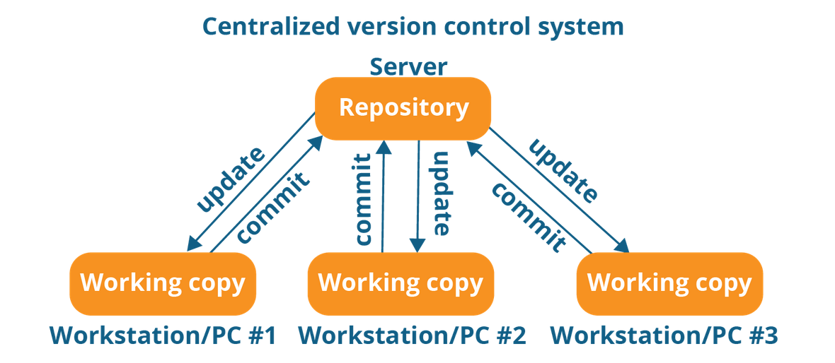
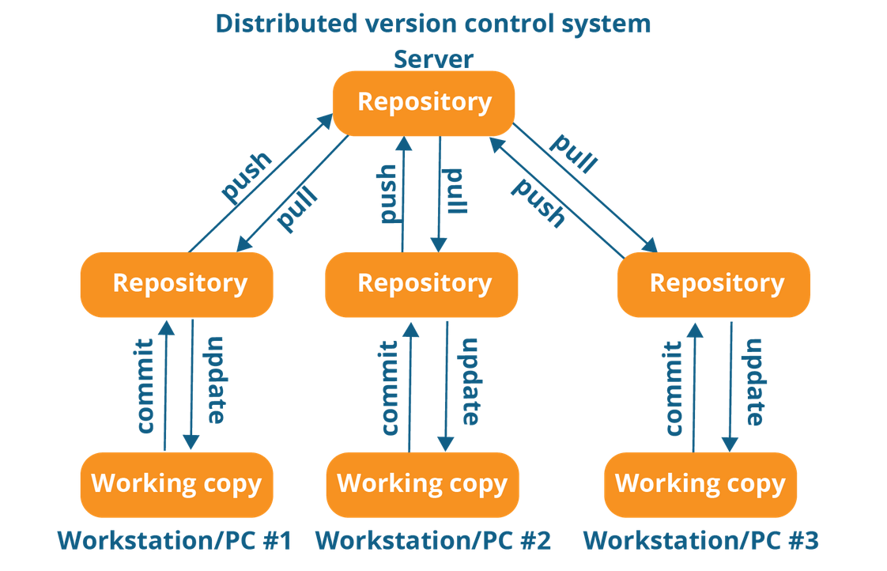
Types of VCS
CVCS DVCS

Slide 6
Benefits of Version Control:
Track Changes: See who made changes and when.
Collaborate Effectively: Multiple developers can work on the same code without interfering with each other’s work.
Branching and Merging: Experiment with new features by creating branches, and merge them when ready.
Backup and Restore: If something breaks, you can always revert to a previous version.
Audit Trail: Keep a history of all changes, which is valuable for debugging, collaboration, and accountability.
Conclusion:
Version control is an essential practice in modern software development. It provides a systematic way to manage code changes, enabling collaboration, transparency, and safety in the development process.

Slide 7
Key Git Concepts

Slide 8
Key Git Concepts
Repository: A directory that contains your project files and tracks their history. There are two types of repositories in Git:
Local repository: Stored on your local machine, where you do your work.
Remote repository: Stored on a server (like GitHub) for sharing with others.
Commit: A snapshot of your changes. Every time you commit, Git records a version of your project at that point in time.
Branch: A separate line of development. Each branch represents a version of the project that can diverge from the main codebase. The default branch in Git is called main or master.
Merge: Combining changes from one branch into another. This is crucial when multiple people are working on different features or parts of a project.
Stage: A place to prepare changes before committing them. Files added to the stage are ready to be committed.
HEAD: A pointer to the current branch you are working on. It usually points to the latest commit in that branch.

Slide 9
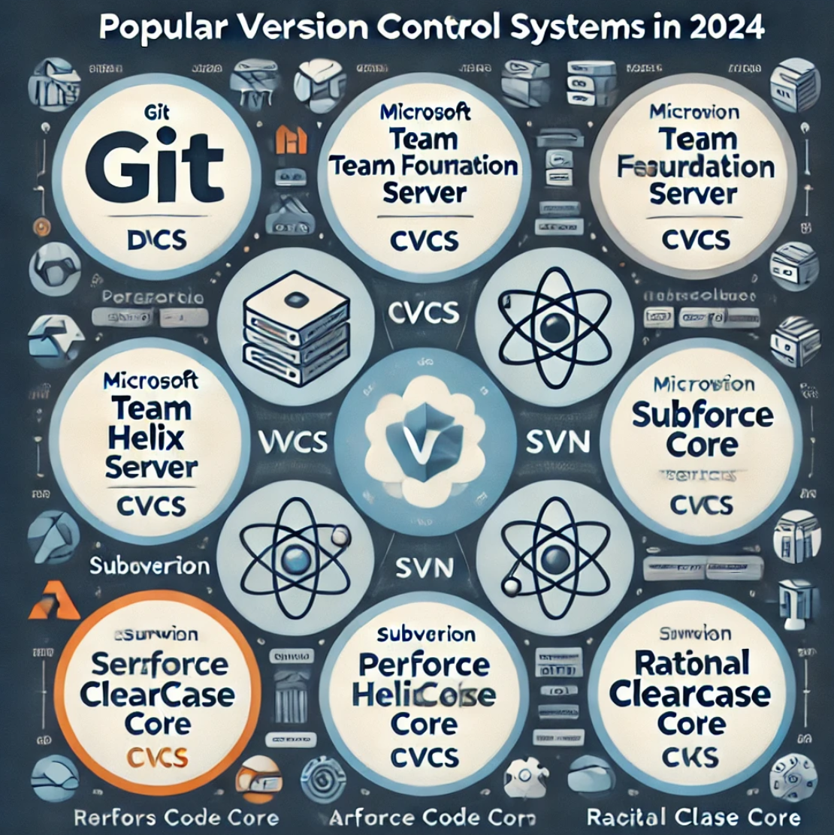
Popular VCS in 2024

Slide 10
GIT (DVCS)

Slide 11
What is GIT?
Git is a distributed version control system that helps developers track changes in their code and collaborate with others. It's widely used for managing the source code in software development projects, allowing multiple developers to work on the same codebase without interfering with each other’s work.

Slide 12
Key Features of GIT
Git is a powerful version control system with many features designed to facilitate collaborative software development, track changes in files, and provide efficient workflows. Here are the key features of Git:

Slide 13
Key Features of GIT –Con’t
Distributed Version Control System
Description: Unlike traditional centralized version control systems (CVCS), Git is distributed, meaning each developer has a complete copy of the repository, including the full history of the project, on their local machine.
Benefit: Developers can work offline and perform most Git operations (like commits, branches, and history viewing) without needing an internet connection. Once they’re online, they can sync changes with the central repository.
Branching and Merging
Description: Git allows for branching - creating a separate line of development for new features or fixes. Developers can work in isolation on branches and merge them back into the main branch when ready.
Benefit: This promotes parallel development. Developers can experiment freely without affecting the main codebase, and later merge changes into the main branch with minimal conflict.
Staging Area
Description: Git uses a staging area (also known as the index), where files are placed before committing them to the repository. This allows you to commit only the changes you’ve selected, even if you’ve made modifications to multiple files.
Benefit: It gives you control over which changes get committed, allowing for more organized and structured commits.

Slide 14
Key Features of GIT –Con’t
Commit History and Tracking
Description: Git tracks every change made to the project with a commit history. Each commit has a unique identifier (SHA hash), and it contains details such as who made the change, when it was made, and the exact differences between versions (what was added, removed, or modified).
Benefit: This allows for easy tracking of changes over time, auditing who made specific changes, and reverting to previous versions if needed.
Collaboration
Description: Git enables collaboration among multiple developers, allowing them to work on the same project simultaneously. Developers can pull changes made by others and push their own changes to a shared remote repository (e.g., GitHub, GitLab).
Benefit: Git supports workflows such as pull requests and merging, which help developers collaborate effectively and integrate changes without causing conflicts.
Remote Repositories
Description: Git can interact with remote repositories hosted on platforms like GitHub, GitLab, or Bitbucket. These repositories allow developers to share code and collaborate on projects.
Benefit: It centralizes code sharing, supports collaboration, and allows for easy backup and access to the project code from anywhere.

Slide 15
Key Features of GIT –Con’t
Distributed Workflow
Description: Each user has their own copy of the repository. Changes can be made locally, and when the user is ready, they can push their changes to the remote repository or pull changes from others.
Benefit: This allows for independent work, and developers can work independently or in parallel without having to directly interact with each other’s code unless they choose to merge changes.
Easy Branch Management
Description: Git makes it very easy to create, list, delete, and switch between branches. The branching model is simple and efficient, allowing a clean way to manage different versions of a project.
Benefit: Developers can create a new branch to work on a feature or fix, and then merge it back into the main branch when it’s finished. This simplifies versioning and makes it easy to try new things without disrupting the main codebase.
Conflict Resolution
Description: Git provides tools to handle merge conflicts, which happen when two developers make changes to the same part of a file. Git will mark the conflict and give developers the opportunity to resolve the conflict manually.
Benefit: This makes collaboration smoother and provides transparency in the process of resolving conflicting changes.

Slide 16
Key Features of GIT –Con’t
Integrity and Security
Description: Git uses SHA-1 hashes for commit objects, meaning that each change in the repository is cryptographically secured. Git ensures data integrity and prevents unauthorized changes.
Benefit: Git’s security features guarantee that the commit history is authentic and that the project’s code has not been tampered with.
Support for Large Projects
Description: Git is optimized for handling large projects efficiently, with a large number of files and substantial history. It can perform operations like cloning, committing, and pushing quickly even in large codebases.
Benefit: Git works well even with large-scale projects, offering speed and reliability for complex codebases.
Lightweight and Fast
Description: Git is designed to be fast and efficient, with operations like commits, branching, and switching between branches being executed quickly.
Benefit: Git’s speed makes it ideal for large teams and fast-paced projects, where quick feedback loops are essential.

Slide 17
Summary of Git Features:
Distributed Version Control – Local repositories with full history.
Branching and Merging – Parallel development with feature isolation.
Staging Area – Selective commits.
Commit History – Track changes, revert versions.
Collaboration – Easy teamwork with remote repositories.
Remote Repositories – Centralized code sharing.
Distributed Workflow – Independent work with synchronization.
Branch Management – Simple and flexible branching.
Conflict Resolution – Tools for handling merge conflicts.
Integrity and Security – Cryptographic integrity using SHA-1 hashes.
Support for Large Projects – Efficient with large codebases.
Lightweight and Fast – Optimized for speed and scalability.

Slide 18
Why Use Git?
Tracking Changes: Git keeps track of every change made to a project, so you can easily see what has been modified, by whom, and when.
Reverting Changes: If a mistake is made, Git allows you to revert back to a previous state.
Collaboration: Git is essential for teams to collaborate on code. It ensures that changes made by different team members can be merged into the main project without issues.
Branching & Merging: Allows experimentation with new features without affecting the stable codebase, and when ready, branches can be merged back.

Slide 19
Common Git Commands
git init: Initialize a new Git repository.
git add: Stages files for commit.
git commit: Records changes to the repository.
git status: Checks the status of the repository.
git push: Pushes changes to a remote repository.
git pull: Pulls changes from a remote repository.
git branch: Lists, creates, or deletes branches.
git merge: Merges changes from one branch into another.

Slide 20
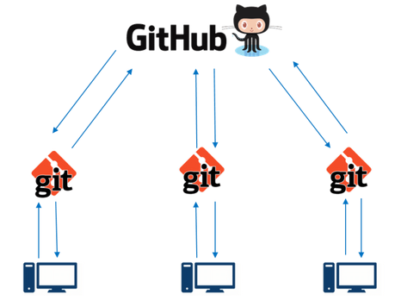
Functions and capabilities of github
GitHub is a web-based platform that hosts Git repositories and provides a variety of tools for collaboration, version control, and project management. While Git is a version control system that operates locally, GitHub provides a remote, cloud-based service where developers can store their repositories, share code with others, collaborate on projects, and manage software development workflows.
GitHub is built around Git, and it integrates with Git to provide several advanced features to developers.

Slide 21
Key Features of GitHub
1. Remote Repository Hosting
Description: GitHub hosts remote Git repositories, allowing developers to store their code on a central platform. This enables them to share their projects, collaborate with others, and access code from anywhere.
Benefit: You can access your repositories from multiple devices, and your work is backed up in the cloud.
2. Collaboration Tools
Pull Requests (PR): GitHub enables collaboration via pull requests. When a developer creates a branch and makes changes, they can submit a pull request to the main branch for review. Team members can review, comment, and suggest changes before merging the code into the main branch.
Issue Tracking: GitHub provides issue tracking tools to manage tasks, bugs, feature requests, and project planning. Issues can be created, assigned to team members, and linked to pull requests.
Comments and Reviews: Developers can comment directly on code in pull requests, review changes, and leave feedback, ensuring smooth collaboration and communication.
3. Forking and Cloning
Forking: You can fork a repository, which means creating a personal copy of someone else’s repository. You can make changes in this copy and, if desired, submit a pull request back to the original repository.
Cloning: Cloning allows you to make a copy of a remote repository to work on it locally. This is how you get a local version of a GitHub repository on your machine to make changes.
4. Branching and Merging
Branching: GitHub integrates Git's branching model, allowing you to create branches within your remote repository. This helps you work on new features or fixes in isolation from the main codebase.
Merging: Once the feature is complete, you can merge the branch into the main branch or any other branch after a review process via pull requests.

Slide 22
Key Features of GitHub
5. GitHub Actions (CI/CD)
Continuous Integration and Continuous Deployment (CI/CD): GitHub offers GitHub Actions, which allows you to set up automated workflows for building, testing, and deploying your code. It integrates directly with your GitHub repositories and can automatically trigger tasks on each push, pull request, or merge.
Benefit: You can automate testing, deployment, and other tasks, improving your development workflow and making it easier to catch bugs and deploy updates.
6. Project Management with Projects and Milestones
GitHub Projects: GitHub offers tools for project management, such as Projects (Kanban boards), to organize and prioritize work. This helps track the progress of tasks and issues visually.
Milestones: You can group issues and pull requests under milestones to track the progress of specific releases or features.
7. Documentation with README.md
README.md: Every GitHub repository can include a README.md file, which serves as documentation for the repository. The file typically includes an overview of the project, how to install it, how to contribute, and other relevant information.
Benefit: README files provide a simple and standardized way of documenting projects so others can understand and contribute to them easily.
8. Security Features
Code Scanning and Secret Detection: GitHub provides features like CodeQL to automatically scan your code for vulnerabilities. It can also detect secrets like API keys and passwords accidentally committed to the repository.
Dependabot Alerts: GitHub can automatically track outdated dependencies and vulnerabilities in third-party libraries, providing alerts and even creating pull requests for updates.

Slide 23
Key Features of GitHub
9. GitHub Pages
Description: GitHub provides a feature called GitHub Pages, which allows you to host static websites directly from a GitHub repository. It’s commonly used for project documentation, personal websites, or portfolios.
Benefit: It’s a simple way to host and share web content without needing an external web hosting service.
10. Open Source Community
Description: GitHub is home to millions of open-source projects. Developers can contribute to open-source repositories, report issues, and submit patches to projects they care about.
Benefit: By using GitHub, developers can engage with a global community of programmers, contribute to existing projects, or launch their own open-source initiatives.

Slide 24
Why Use GitHub?
Collaboration: GitHub makes it easy for multiple developers to work on the same codebase. With features like pull requests, code reviews, and issue tracking, developers can collaborate efficiently and prevent conflicts.
Backup and Remote Storage: Storing your code on GitHub ensures that it’s backed up and available from any device, reducing the risk of losing your work.
Version Control in the Cloud: GitHub integrates Git’s version control system, making it easy to keep track of changes and versions, and collaborate with other developers.
Automated Workflows: With GitHub Actions, you can automate your build, test, and deployment processes, saving time and reducing errors.
Open-Source Contributions: GitHub is the hub of open-source projects, where developers can contribute to community-driven software, learn from others, and share their own projects.

Slide 25
Common GitHub Commands
git clone <repository_url>: Clone a repository from GitHub to your local machine.
git push origin <branch_name>: Push your local changes to the remote repository on GitHub.
git pull origin <branch_name>: Pull the latest changes from the remote repository into your local machine.
git fork <repository_url>: Fork a repository to create your own copy of it.
git remote add origin <repository_url>: Link your local repository to a GitHub repository.

Slide 26
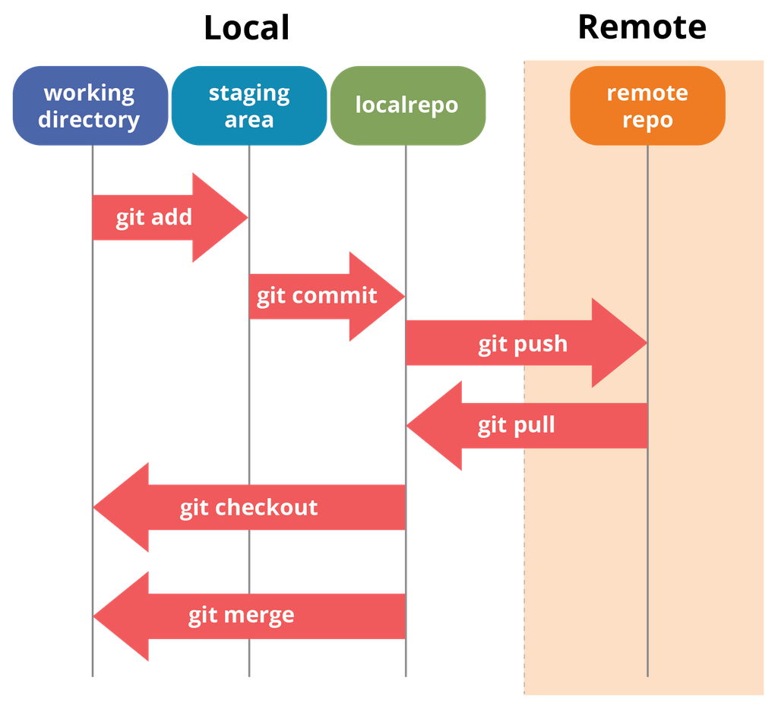
Local Workflow

Slide 27
Git Workflow Breakdown
Local Section:This section shows the different parts of your local repository, and the commands used to interact with them.
Working Directory (Leftmost part):
Definition: This is where your actual files live on your computer. It represents the files that you're actively working on in your project.
Key Action: Modifying, creating, or deleting files happens here.
Command:
git add: Adds modified files from the working directory to the staging area.
Example Command: git add README.md will stage the README.md file.
Staging Area (Middle-left part):
Definition: This is where Git keeps track of changes that you want to include in your next commit. It’s like a "pre-commit" area where you review your changes before committing them.
Key Action: Files are staged here after modification before being committed to the local repository.
Command:
git commit: Saves changes from the staging area to the local repository.
Example Command: git commit -m "Add new feature" will commit the staged changes to your local Git repository.

Slide 28
Git Workflow Breakdown
Local Repository (Middle-right part):
Definition: This is where Git stores your committed changes locally, in the .git folder. It contains all the history and changes of your project.
Key Action: After committing, your changes are saved here.
Command:
git checkout: Allows you to switch between branches in the local repository.
Example Command: git checkout main switches to the main branch in the local repository.
git merge: Combines changes from different branches in the local repository.
Example Command: git merge feature-branch merges the feature-branch into your current branch (usually main).

Slide 29
Remote Section:
Remote Section: This section deals with the remote repository (e.g., GitHub, GitLab), which is hosted online and used for collaboration.
Remote Repository:
Definition: This is the Git repository hosted on a remote server (e.g., GitHub). It stores the official version of your project, making it accessible for collaboration.
Key Action: Remote repositories are used for collaborating with others by pushing changes to the remote server or pulling updates from others.
git push:
Definition: The git push command sends your local commits from your local repository to the remote repository. It’s how you share your changes with others.
Key Action: This is how you upload your work to a remote server (e.g., GitHub).
Command:
git push origin main: Pushes the local main branch to the origin remote (e.g., GitHub).
git pull:
Definition: The git pull command fetches changes from the remote repository and merges them into your local repository. This is how you stay up-to-date with changes made by others.
Key Action: You use git pull to get updates or changes made by collaborators in the remote repository.
Command:
git pull origin main: Pulls the latest changes from the main branch of the origin remote (e.g., GitHub) into your local repository.

Slide 30
Summary of Workflow:
Working Directory → Staging Area → Local Repository:
You make changes to files in your working directory.
Then, you add those changes to the staging area using git add.
After reviewing, you commit the changes to the local repository using git commit.
Local Repository → Remote Repository:
When you're ready to share your work, you use git push to send your local commits to the remote repository.
When working with a team, you will often need to run git pull to get the latest changes from the remote repository and merge them into your local repository.

Slide 31
Commands Summary
git add: Stages changes (Working Directory → Staging Area).
git commit: Commits changes to the local repository (Staging Area → Local Repository).
git push: Pushes commits to the remote repository (Local Repository → Remote Repository).
git pull: Fetches and merges changes from the remote repository to the local repository (Remote Repository → Local Repository).
git checkout: Switches between branches (Local Repository).
git merge: Merges different branches in the local repository (Local Repository).

Slide 32
